Slide 1
Restaurant in rome
Cousera capstone project

Slide 2
BUSINESS PROBLEM
The objective of this capstone project is to analyse and select the best locations in the city of Rome to open a new restaurant.
Using data science methodology and machine learning techniques like clustering, this project aims to provide solutions to answer the business question:
In the city of Rome, if a property developer is looking to open a new restaurant, where would you recommend that they open it?

Slide 3
RETRIEVING DATA
To solve the problem, we will need the following data:
List of neighbourhoods in Rome. This defines the scope of this project which is confined to the city of Rome, the capital city of the country of Italy
Latitude and longitude coordinates of those neighbourhoods. This is re-quired in order to plot the map and also to get the venue data
Venue data, particularly data related to restaurant. We will use this data to perform clustering on the neighbourhoods.

Slide 4
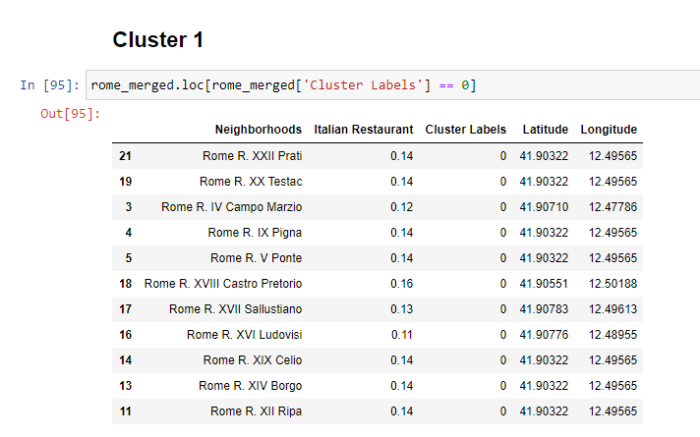
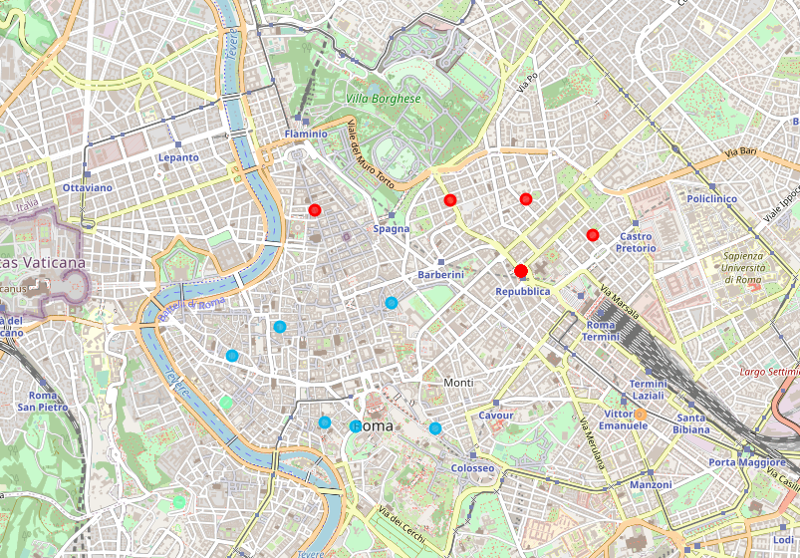
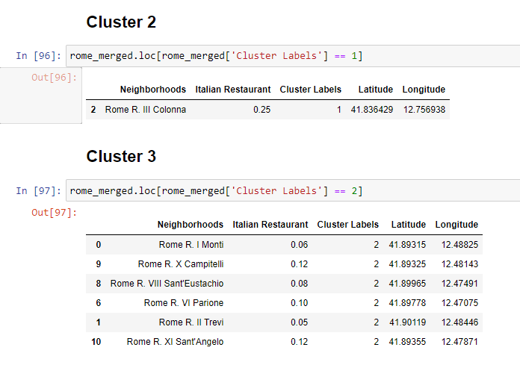
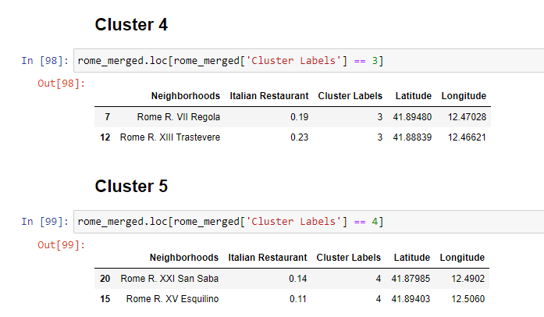
RESULT

Slide 5
DISCUSSION
Most of the restaurant are concentrated in the central area of Rome, with the highest number in cluster 2,3,4 and moderate number in cluster 5
Therefore, this project recommends property developers to capitalize on these findings to open new restaurants in neighborhoods in cluster 3 with little to no competition..

Slide 6
THANKS

